Slide 1
PHISHING ATTACK
By :-
DEEP PATEL

Slide 2
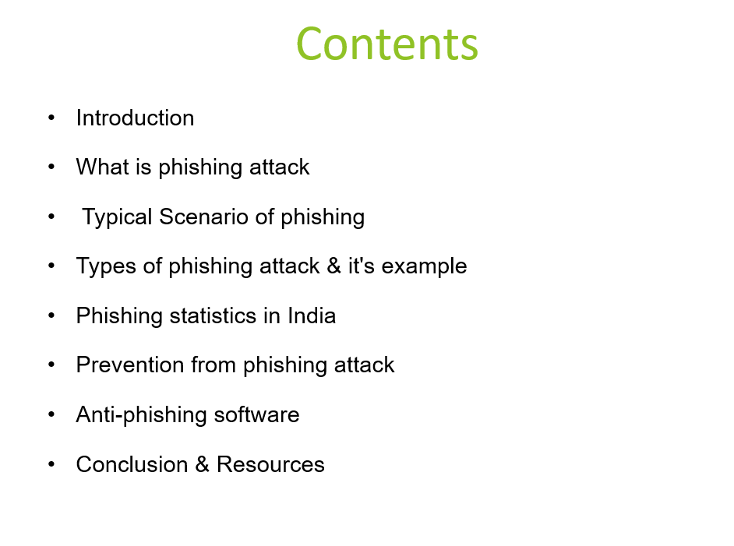

Slide 3
Introduction
Phishing is a type of social engineering attack often used to steal user data, including login credentials and credit-card numbers.

Slide 4

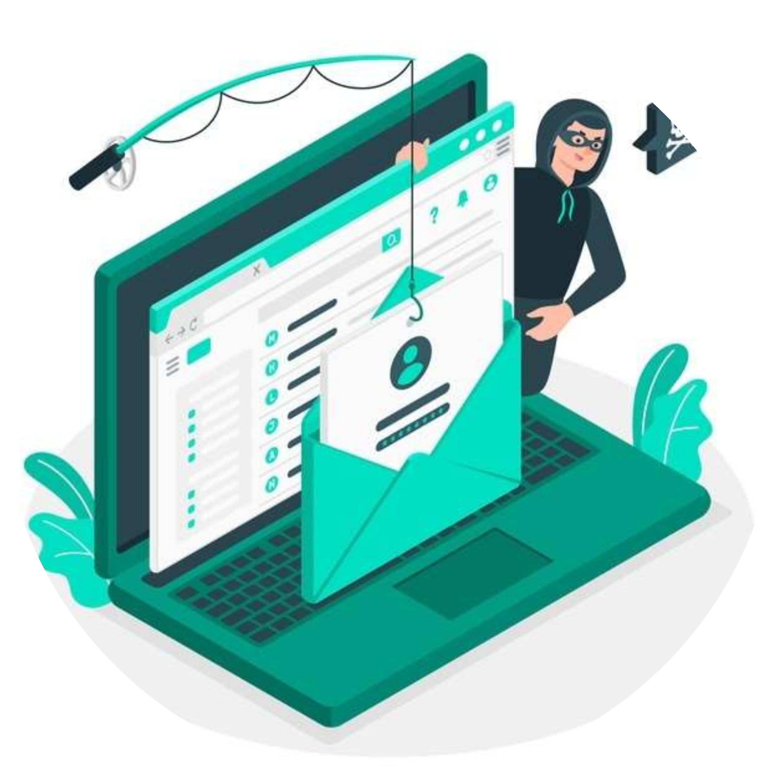
What is Phishing?
The term Phishing can be defined as an act of attempting to acquire sensitive information by pretending to be a trustworthy entity.

Slide 5
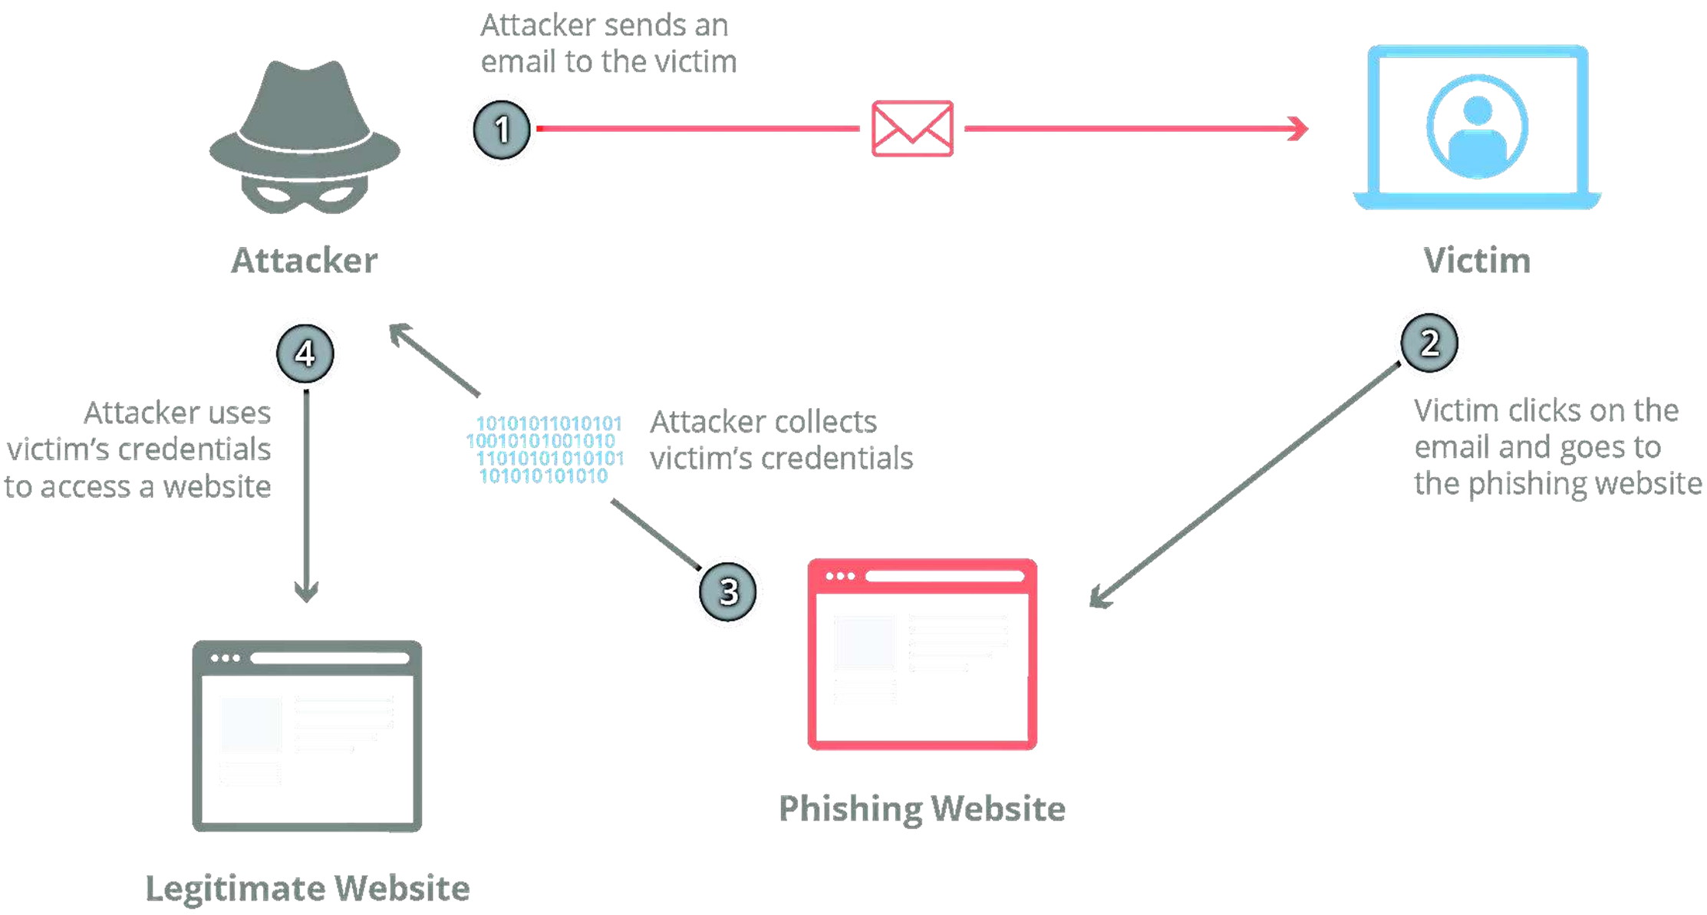
Typical Scenario of Phishing Attacks

Slide 6



Types of Phishing Attacks
EMAIL PHISHING CLONE
PHISHING
SPEAR PHISHING VOICE
PHISHING

Slide 7
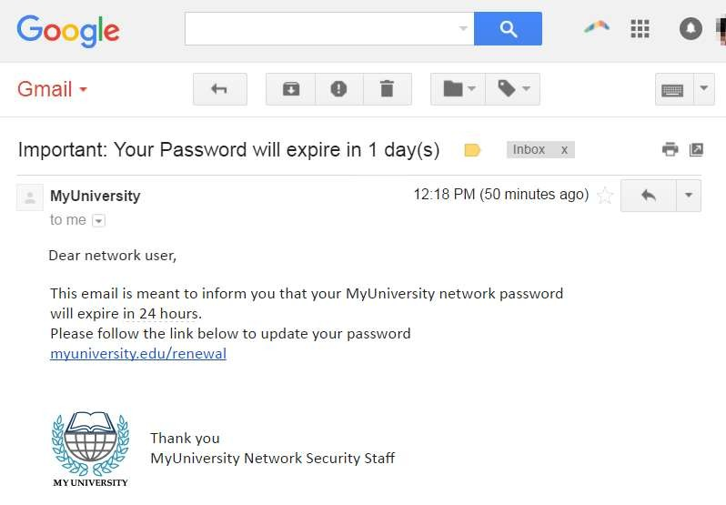
Email Phishing & it's Example
The most widely known form of phishing, this attack is an attempt to steal sensitive information via an email that appears to be from a legitimate organization.

Slide 8
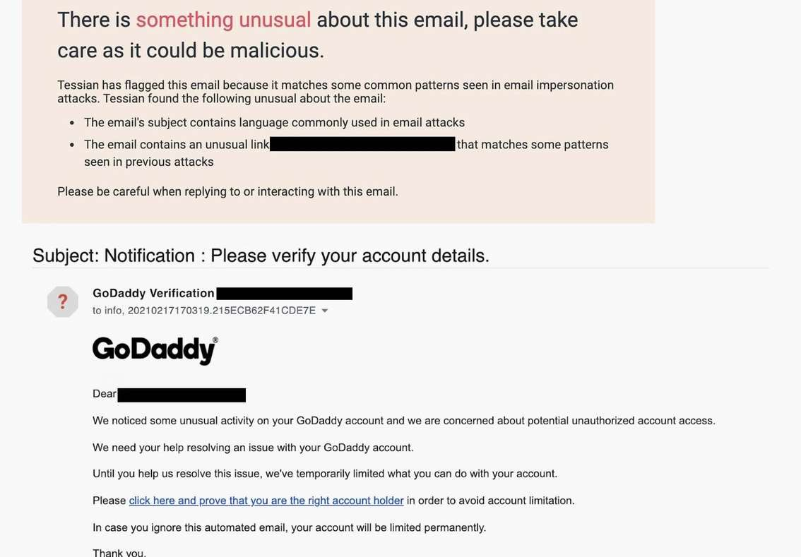
Spear Phishing & it's Example
These email messages are sent to specific people within an organization, usually high-privilege

Slide 9
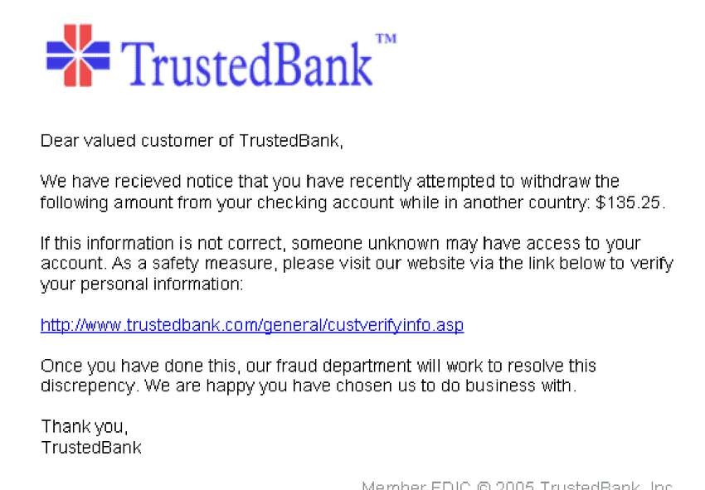
Clone Phishing & it's Example
In this type of phishing, the attacker clones a genuine or legitimate email that you might have received from an authentic sender but sent from a spoofed email id

Slide 10
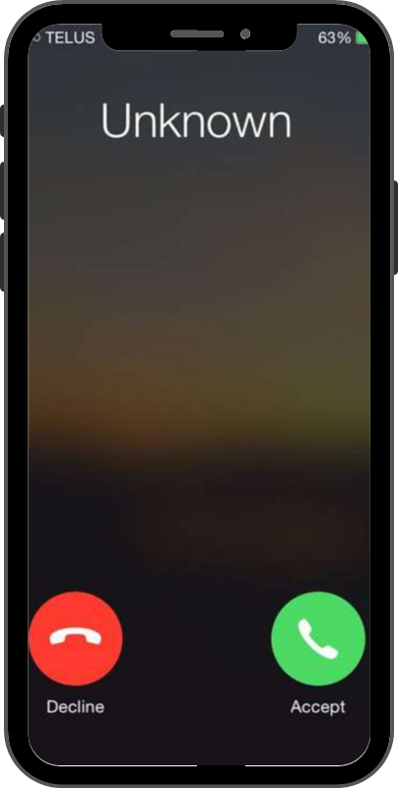
Voice Phishing & it's Example
Voice phishing is the use of fraudulent phone calls to trick people into giving money or revealing personal information.

Slide 11
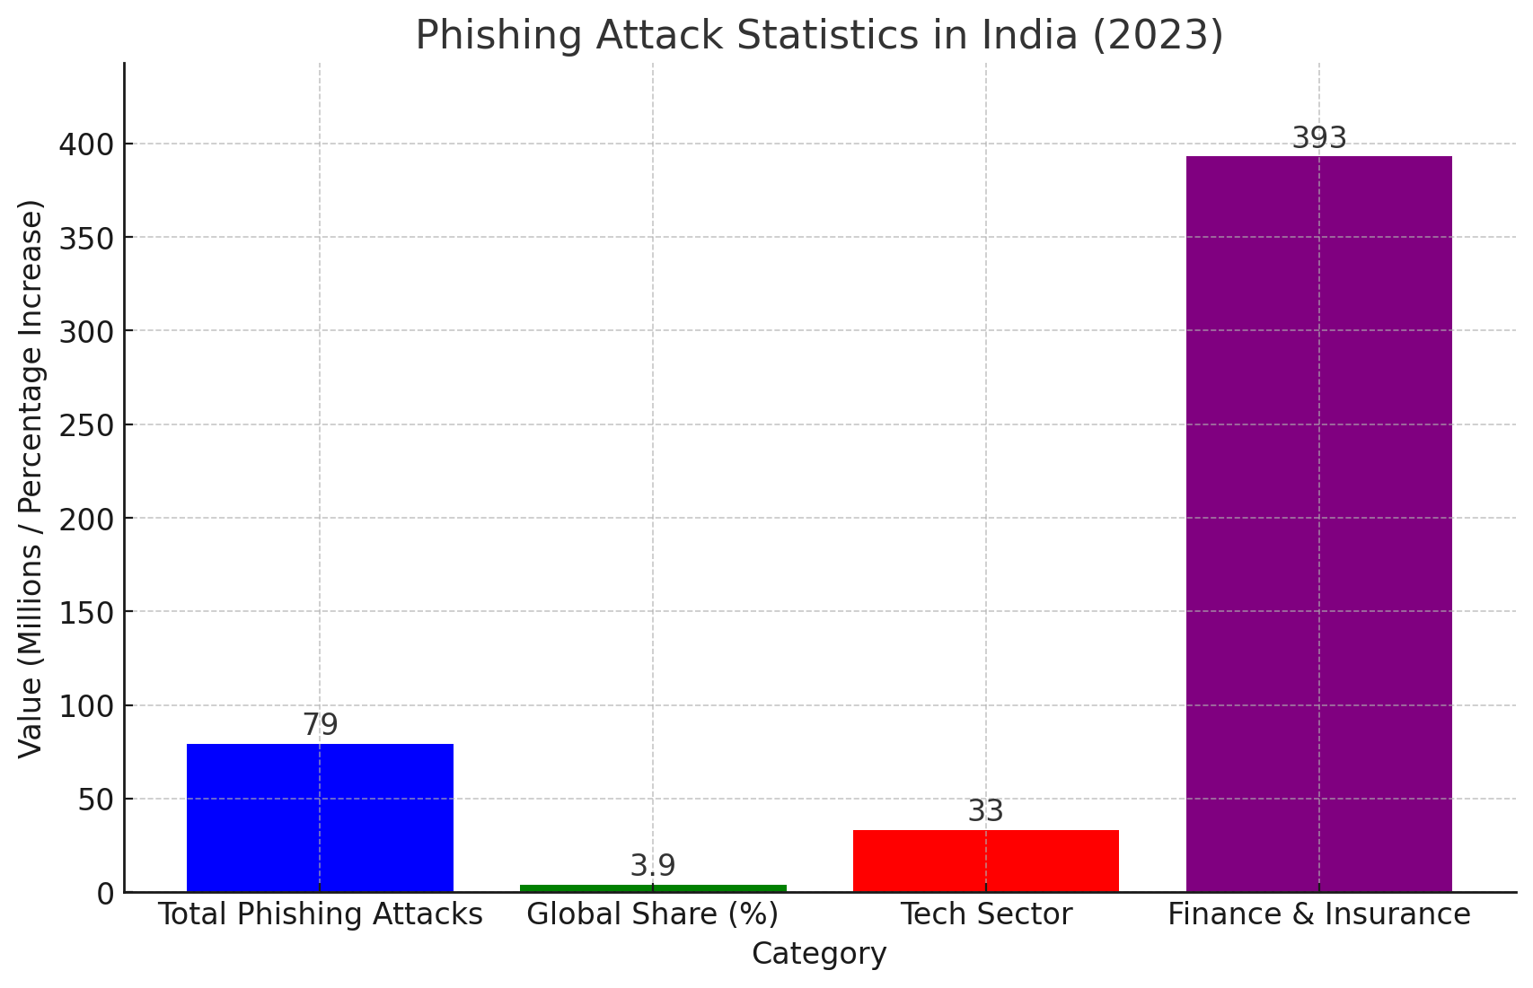
PHISHING ATTACK STATISTICS IN INDIA
Here is a bar graph representing phishing attack statistics in India for 2023:-
Total Phishing Attacks: 79 million incidents.
Global Share: 3.9% of phishing attacks worldwide.
Technology Sector Impact: 33% of attacks targeted this industry.
Finance & Insurance Growth: A 393% increase in phishing attempts.
This visualization highlights the growing threat of phishing attacks in India and the need for stronger cybersecurity measures.

Slide 12
PREVENTIONS FROM PHISHING ATTACK
Think Before You Click: Always verify links before clicking.
Never Share Sensitive Information via Email: Banks and legitimate organizations never ask for sensitive information via email.
Double-Check Unexpected Messages: If an email seems suspicious, call the sender directly.
Stay Informed with Cybersecurity Awareness Training: Regular training helps prevent attacks.

Slide 13
ANTI-PHISHING SOFTWARE
PhishMe: Offers training and simulation tools to help organizations educate employees about phishing threats.
Co-fense: Provides a comprehensive phishing detection and response platform, including user training and incident reporting.
Barracuda Networks: Offers email security solutions that include anti-phishing features, spam filtering, and advanced threat protection.
Proofpoint: Provides email security solutions that protect against phishing, malware, and other email-borne threats.
Norton Anti-Virus: Includes anti-phishing features as part of its broader cybersecurity suite, protecting users from online threats.

Slide 14
Conclusion & Resources
Summary of key points: Recap phishing types, recognition, and protection.
Cybersecurity resources: Websites like CISA, FTC, and Anti-Phishing Working Group.
Contact information for reporting phishing attempts: IT helpdesk, cybersecurity team, and government reporting portals.

